Slide 1
The Scheduling app
Group #4
Gabriel Long | Luke Fleming
Logan Craig | Gartrel Barnes
Daniel Kakwata | Gary Locklear

Slide 2
Introduction
Problem Statement
With the advent of the digital age has brought on the need to modernize and improve every aspect of business, for us one such improvement we saw that was needed was the way in which we set our schedules.

Slide 3
The development Steps
Requirement Specification
Use Cases, Functional and Non-Functional requirements
Design
Sequence and Class diagram
Implementation
Brief video on the implimentation
Test plan
Methods used

Slide 4

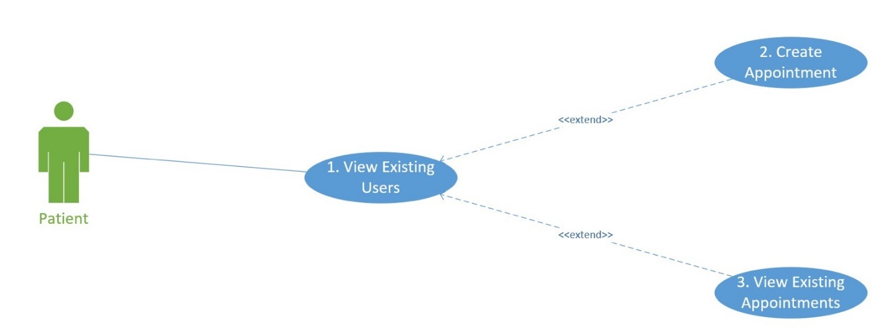
Requirement Specification Use Case Diagram

Slide 5
Use Cases in Detail
View existing User
Use case name | View existing users
Participating Actors | Patient
Entry condition | None
Exit condition | None
Flow of the event | Enter the home screen Request to see view existing users View existing users Option to create a new appointment or view existing appointment.
Use case name | Create Appointment
Participating Actors | Patient
Entry condition | View Existing Appointments
Exit condition | None
Flow of the event | Enter Home Screen Request to view existing users View Existing Users Request to Create appointment for client selected Create Appointment Add new appointment to list of Existing appointments
Use case name | View existing Appointments
Participating Actors | Clients and Patients
Entry condition | View Existing Users
Exit condition | None
Flow of the event | Enter the home screen Request to see view existing users View existing users Request to view existing appointments View Existing Appointments

Slide 6
Requirements
Functional
A login textbox
A textbox that is used to enter and view the appointment list
Registry of users
The registry of users that can be accessed and viewed by users
Appointment creation function
function will take the user selected from the registry and create an appointment and add the information to the registry of appointments.
Non-Functional
Loading Times
The program must run in 1 sec
Usability
Must be accessible via apple Itunes, android store

Slide 7
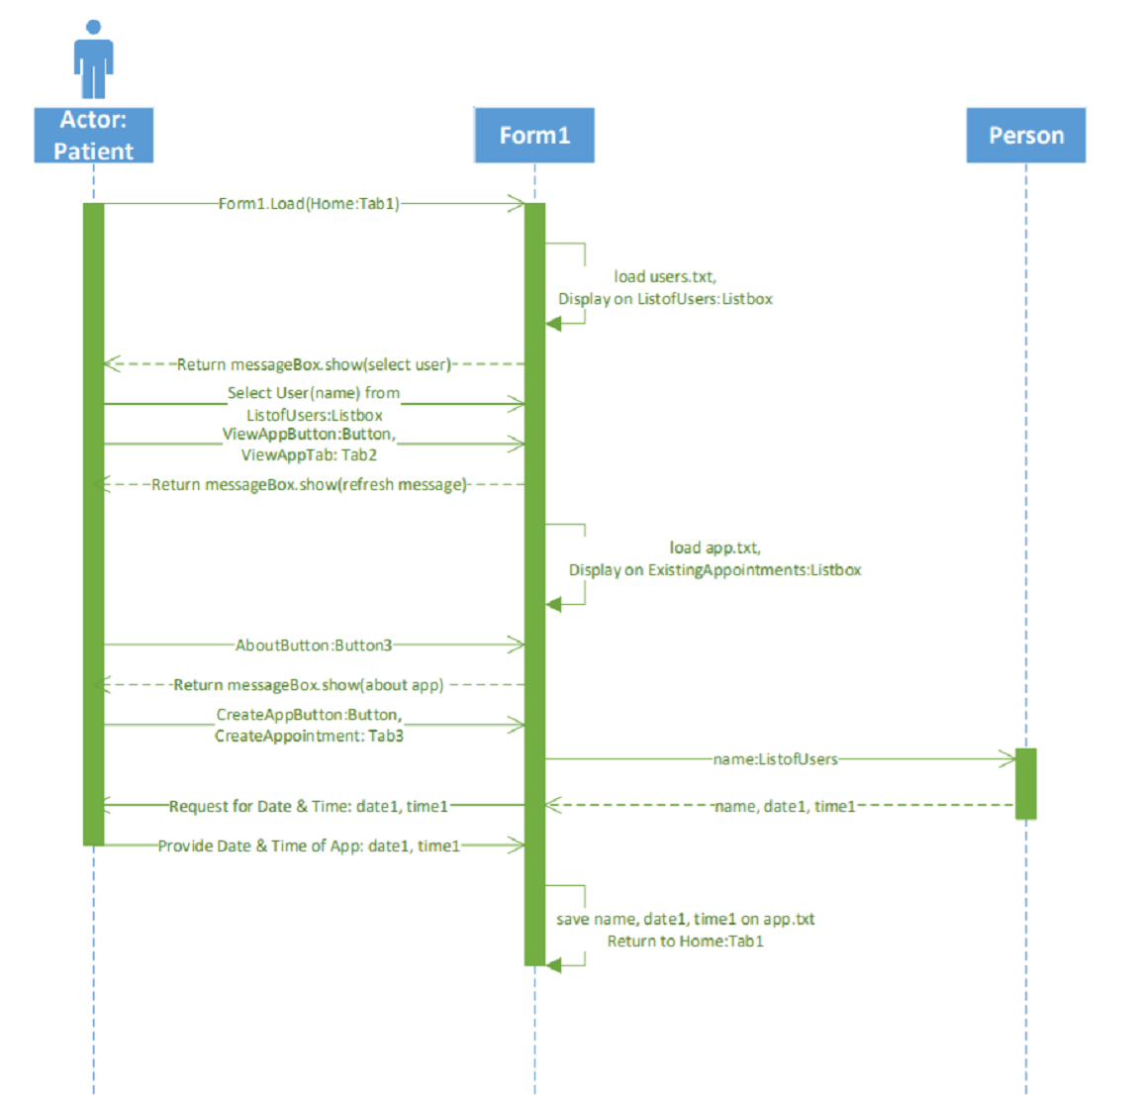
Design Sequence Diagram

Slide 8
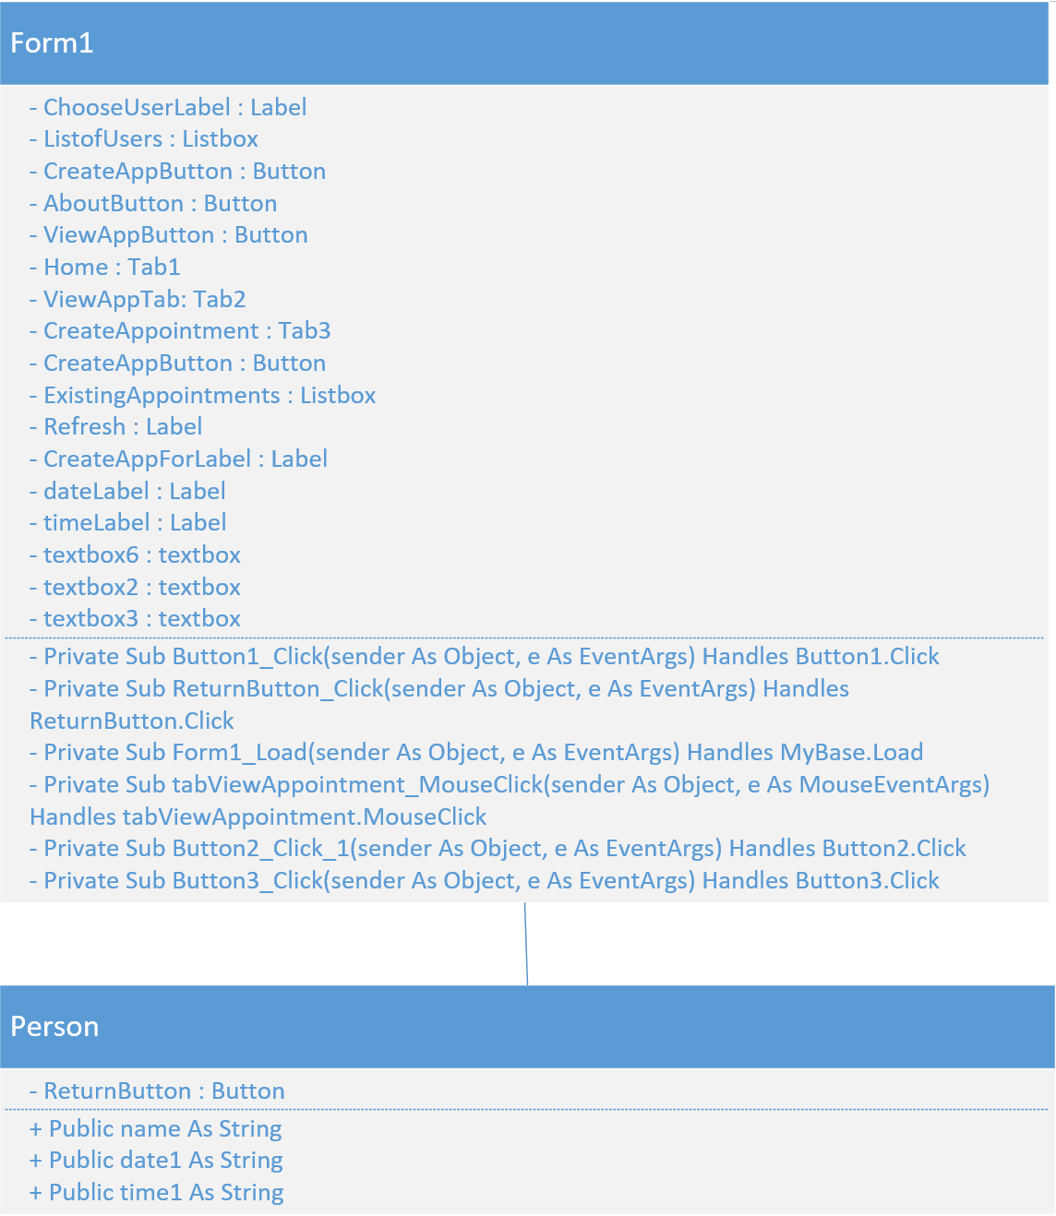
Design Class Diagram

Slide 9
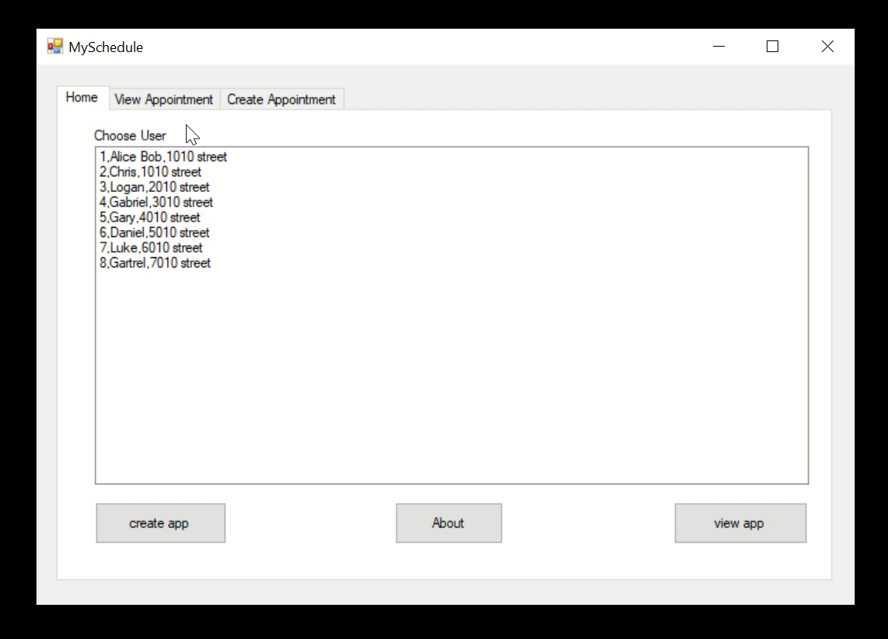

Slide 10
Testing The Application
The method we chose was Blackbox
Easiest method that focuses on the inputs and outputs of the program

Slide 11
Thank you for your Attention
Have a nice day

